Slide 1
CprE 431
Team 12 Presentation
By Sean Gordon, Jacob Vaughn, Richa Patel, Lorenzo Chavarria, and Xin Wang

Slide 2

What it is and how it is done
This attack happened in July 15,2020.
The accounts on Twitter were compromised by outside parties to promote the bitcoin scam.
It required the attackers to get the access of the internet network and the employee credentials which allowed them to get the access to the tools.
The scam asked the individuals to send bitcoin currency.
130 accounts were affected.
The scam involved social engineering, and the attackers manipulated a number of employees.
The method used was the phone spear phishing attack.

Slide 3
Social Engineering
Social engineering is defined as the use of influence and persuasion to deceive people for the purpose of obtaining information or persuading the person to perform an action. [1]
Three types of Social Engineering
Phishing
Spear-phishing
Whaling

Slide 4
Spear-phishing
Spear-phishing target is usually a specific individual or organization. Spear-phishing often uses some of the victim's personal information to gain the trust of the victim and then interacts with them through Email, social media, cellphone, and other forms to obtain their credentials or financial information.
Spear-phishing emails remained the most popular avenue for attack and were used by 65 percent of all known groups.[2]

Slide 5
Damage Caused
Structural
Hackers tried for access to 130 different accounts.
Successfully gained access to 40 using password resets.
Some of the accounts were high profile users like Barack Obama, Jeff Bezos, and Bill Gates.
Monetary
The attackers made away with $160,000 through bitcoin.
Twitter could be fined between $150 to $250 million by FTC
Notes:
Hi, my name is Sean Gordon, and I’ll be talking about the damages caused by the Twitter hack. Through various press reports and statements from Twitter itself, it can be gleaned that the hackers tried for access to 130 different user accounts, obtaining various amounts of information from each. The hackers successfully gained entry to 40 of those accounts, some of them being high profile users like Barack Obama, Jeff Bezos, and Bill Gates. Using the hacked accounts, the attacker’s phishing emails garnered $160,000 through bitcoin transfers.
Besides the money lost through the scam itself, Twitter is facing down multiple charges for the breach and could be fined between $150 to $250 million dollars. Twitter has also recorded market share drops of 1.6%, and expects lasting damage to business partnerships.
Twitter has said that the hack "may also result in damage to our reputation, loss of accounts, loss of content or platform partners, loss of advertisers or advertising revenue or legal and financial exposure, including legal claims, regulatory inquiries or other proceedings. Any of these effects could have a material and adverse impact on our business, reputation and operating results."

Slide 6
Damage Extended
Damage caused was much less than possible, as the attackers only went for immediate money. The tweets sent could have been designed for a larger political impact.
Potential
Attackers could have damaged a political campaign with tweets.
Attackers could have damaged inter-country relations with military threats.
Only phishing was used; attackers could have distributed malware alongside the original tweets.
Notes:
While the monetary damage to the corporation was significant, the potential damages for a hack of this magnitude are monolithic. The attackers pushed for the relatively tame goal of fishing for money, but if the power these hackers obtained had fallen into the hands of a terrorist organization instead, it could be used to disrupt political campaigns in multiple countries, or to damage inter-country relations and trigger unnecessary responses with fake military threats.
The attack also only lasted around 4 1/2 hours, after which it was shut down by Twitter's recovery attempts. The attack could have lasted much longer however if the attackers decided to distribute malware alongside the plea for bitcoin. Many bitcoin services blocked transactions to the hacker's address, with services like Coinbase blocking approximately 5,670 transfers, with a total value of $1,294,000. If malware was distributed in some of the tweets as well, it is very likely that there would have been many hits, leading to the spread of the malware and vastly increasing the difficulty of controlling and containing the incident.
With access to some of Twitter's admin controls, the attackers could have done significant damage to Twitter itself as well, deleting accounts and information causing irreparable damage, or digging for private, protected information on users in order to sell later.
This hack obviously represents a threat to Twitter's users privacy and data security, and because of this the company is undergoing several audits, which will likely force major, expensive changes throughout not only the company, but across worldwide corporation cybersecurity.

Slide 7
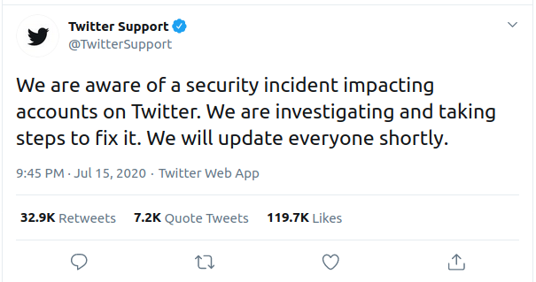
Twitter’s Immediate Response and Action
The first response to the incident was about an hour and a half after the initial hacked tweets were sent out. Shortly after twitter began to disable a large number of accounts stopping them from tweeting, changing their password, and using other account functionality.
Source: [Twitter Support Thread]

Slide 8
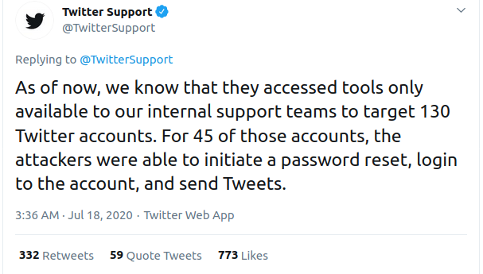
Further Action by Twitter Following the Hack
Once affected accounts were identified Twitter locked down the affected accounts and removed the Tweets posed by the attackers. About 4 hours after the incident most accounts were unlocked enabling them to Tweet again. Accounts that were not unlocked were the accounts affected by the hack and those that had a password change in the last 30 days.
On July 18th Twitter then made the blog post stating that they had restored most of the accounts that were locked pending password changes.
Source: [An update on our security incident]

Slide 9
How to Prevent in Future
Multi-Factor Authentication
Authentication should be more strict and match the risk of access.
Using a different method of authentication like using a physical security key or hardware(like a USB)
Access Management
Limit the number of employees with access to high risk controls like Twitter’s internal tools.
Training on Cybersecurity Awareness
Every employee should have this training.
Regular exercises like phishing should be done to test employees detection abilities.
Have established uniform standards of communications.

Slide 10
Bibliography
Twitter Support Tread: https://twitter.com/TwitterSupport/status/1284331129416200192
Twitter Inc “An update on our security incident” https://blog.twitter.com/en_us/topics/company/2020/an-update-on-our-security-incident.htm
What this attack is:
https://en.wikipedia.org/wiki/2020_Twitter_bitcoin_scam#Method_of_attack

Slide 11
Bibliography
1: “NATIONAL SECURITY AGENCY CYBERSECURITY REPORT” https://www.nsa.gov/Portals/70/documents/what-we-do/cybersecurity/professional-resources/ctr-nsa-css-technical-cyber-threat-framework.pdf
2:”Internet Security Threat Report” https://www.phishingbox.com/downloads/Symantec-Security-Internet-Threat-Report-ISRT-2019.pdf
3:”An update on our security incident” https://blog.twitter.com/en_us/topics/company/2020/an-update-on-our-security-incident.html#:~:text=The%20social%20engineering%20that%20occurred,to%20our%20internal%20support%20tools

Slide 12
Bibliography
Damages:
cnn.com/2020/07/16/tech/twitter-hack-security-analysis/index.html
https://www.forbes.com/sites/mattperez/2020/08/03/twitter-could-be-fined-up-to-250-million-by-ftc-for-massive-hack-in-july/#68bd3b493805
https://www.dfs.ny.gov/Twitter_Report
https://www.theblockcrypto.com/post/71906/twitter-account-hacks-timeline

Slide 13
Bibliography
Update on the incident:
https://blog.twitter.com/en_us/topics/company/2020/an-update-on-our-security-incident.html
How to Prevent in Future:
www.cnbc.com/2019/09/04/how-to-prevent-your-twitter-account-from-being-hacked.html
https://www.dfs.ny.gov/Twitter_Report

